Slide 1






Collaborative Data Science and COVID-19
Assoc Prof Peter Julian Cayton, PhD
School of Statistics, University of the Philippines Diliman
Member, UP COVID-19 Pandemic Response Team
Member, LEADS for Health Security and Resilience

Slide 2

Flow of the Presentation
A Typical Data Science/Analytics Workflow
Membership to Data-Driven Teams
Example Projects
Demonstrating the Workflow with a Team using Example Projects
Closing Remarks

Slide 3
A Typical Data Science/Analytics Workflow

Slide 4

A Typical Data Science/Analytics Workflow
Source: Wickham, H and Grolemund, G (2017). R for Data Science. O’Reilly. https://r4ds.had.co.nz/introduction.html

Slide 5
A Typical Data Science/Analytics Workflow
Import
Extracting the data from an internal database, a file, an online website, or thru a web application programming interface (API), to be loaded in R/RStudio

Slide 6
A Typical Data Science/Analytics Workflow
Tidy
Arranging the data into a neat data structure, with variable as columns and data points as rows.
Included in this step would be data cleaning, data augmentation, missing data imputation, and others

Slide 7
A Typical Data Science/Analytics Workflow
Understand
Generally, the steps to extract insights from data after tidying up.

Slide 8
A Typical Data Science/Analytics Workflow
Transform
Processing the data in preparation for further steps. Examples are:
Narrowing the data, e.g., by region or by age,
Computing new variables, e.g., length of days until recovery, or delays in reporting cases
Aggregating data, e.g., counting cases or solving rates/means

Slide 9
A Typical Data Science/Analytics Workflow
Visualize
Plot data into graphs so that patterns and features may be explored and insights be extracted from what is seen.

Slide 10
A Typical Data Science/Analytics Workflow
Model
When necessary, models help in summarizing the complex relationships and the patterns found from visualizations
Designing models for prediction or forecasting

Slide 11
A Typical Data Science/Analytics Workflow
Communicate
These include:
Writing reports, creating dashboards, making presentations, compilations, etc.

Slide 12
A Typical Data Science/Analytics Workflow
Program
All these processes to be encapsulated in a data science project plan
Possible to be encapsulated in one software, but it’s not impossible to use more than one depending on team members’ capabilities to process and analyze data.

Slide 13
Membership to Data-Driven Teams

Slide 14
About the UP Pandemic Response Team

Slide 15
About UP COVID-19 Pandemic Response Team
Leaders:
Dr Teodoro Herbosa, UP System
Dr Alfredo Mahar Lagmay, Executive Director, UP Resilience Institute
Who we are
200+ experts and volunteers from the whole UP System, from Baguio to Davao
spanning multiple fields: political scientists, statisticians, mathematicians, geographers, geologists, medical doctors, linguists, economists, etc.
Next slides from Dr Lagmay: Our Portfolio

Slide 16
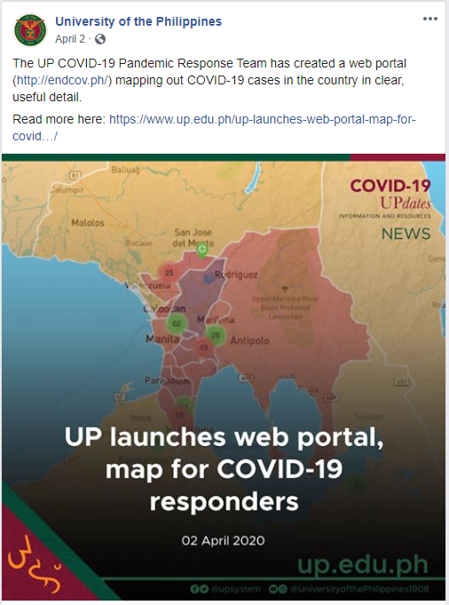
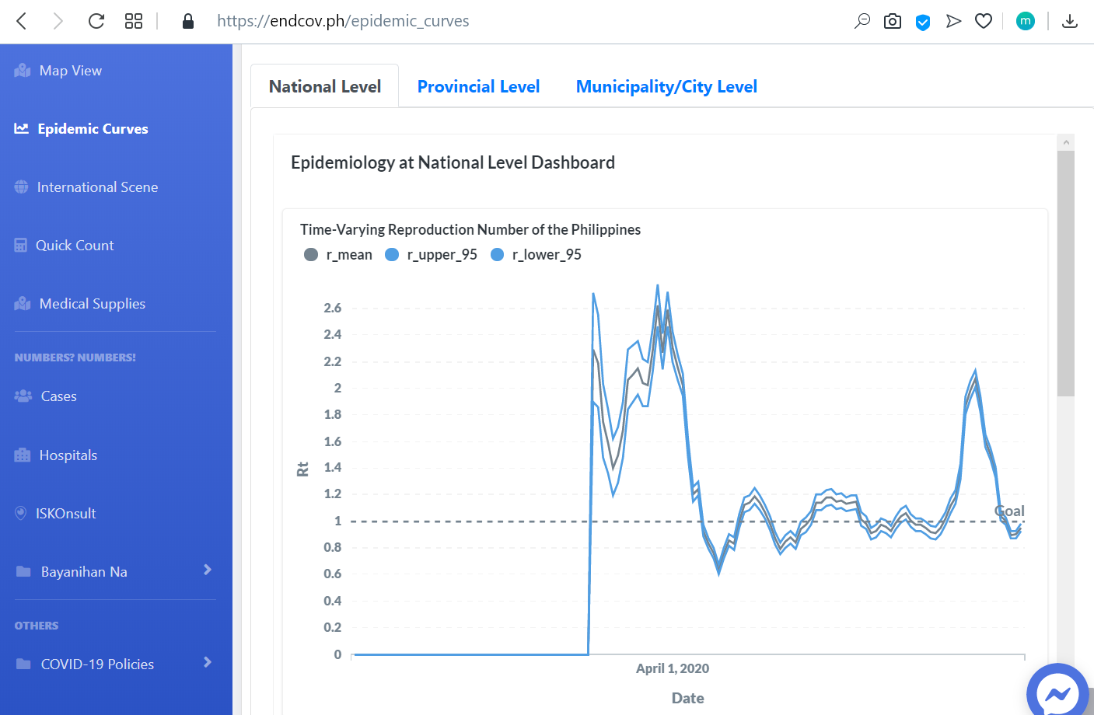

endcov.ph

Slide 17

Yani, the Endcov bot

Slide 18
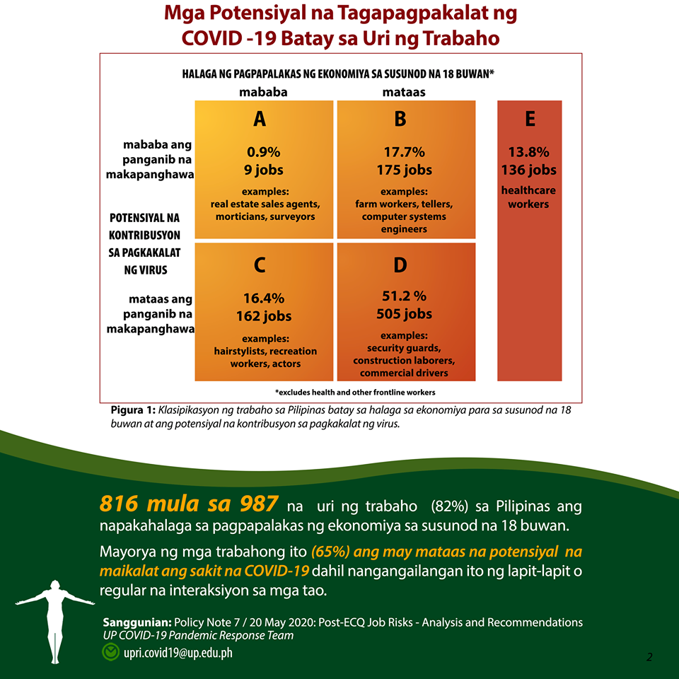
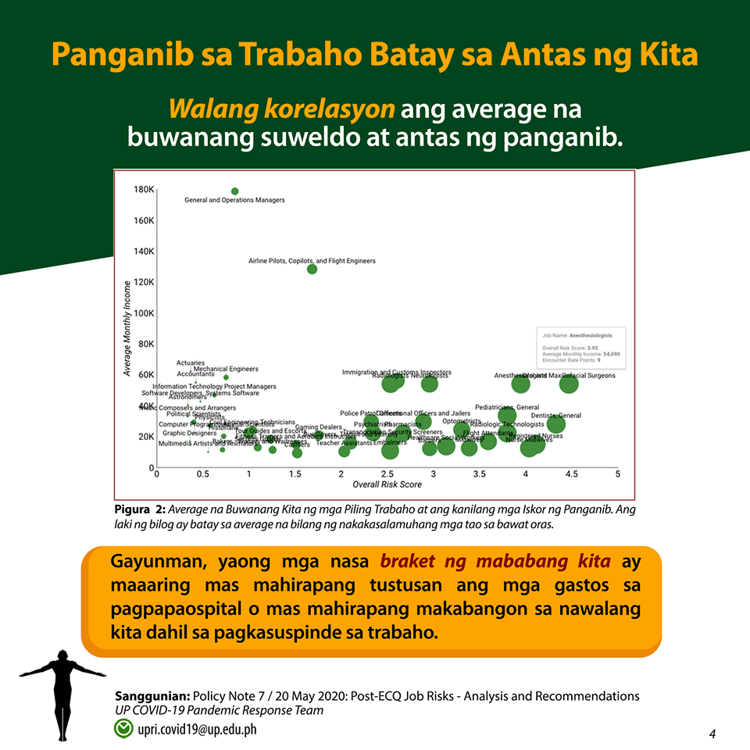
To better inform the general public, the team has also redesigned their studies into animation, video formats and flashcards to be more accessible.

Slide 19
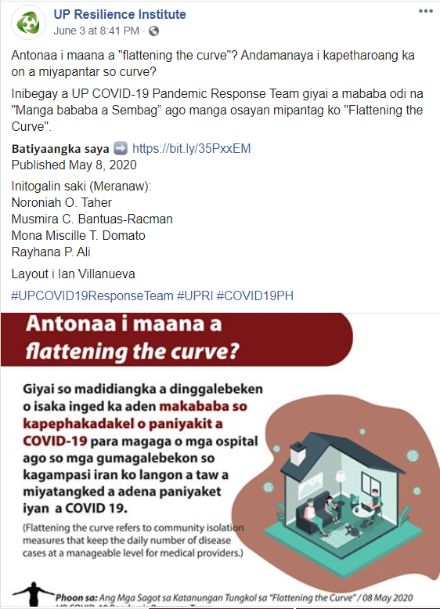
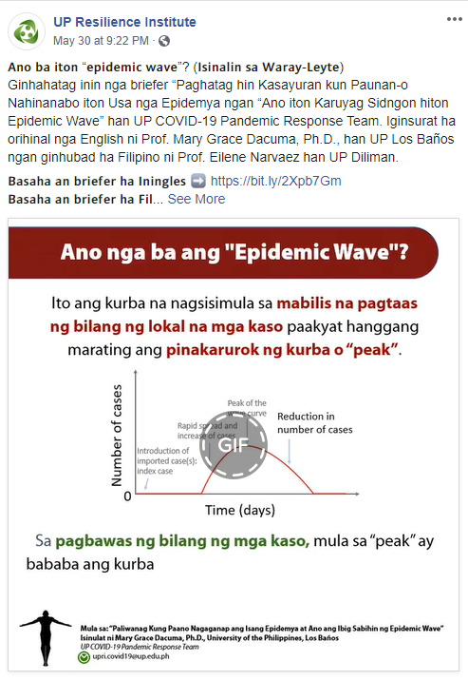
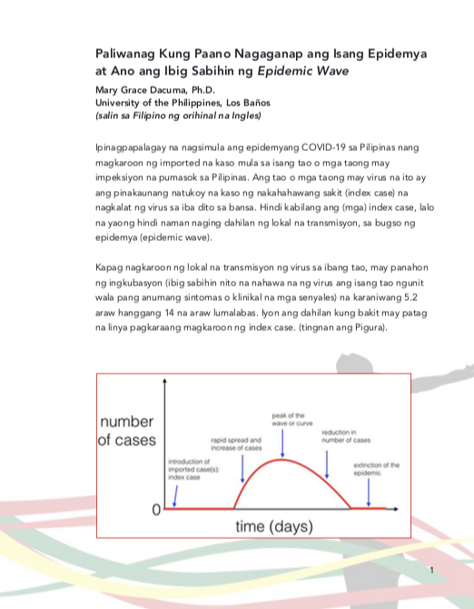
Policy notes are now available in English as well as Tagalog, Ilokano, Bikol Sentral, Waray, Cebuano, Hiligaynon, Aklanon, Kapampangan, Itawis, Chavacano de Zamboanga, Meranaw, and Bahasa Sug.

Slide 20
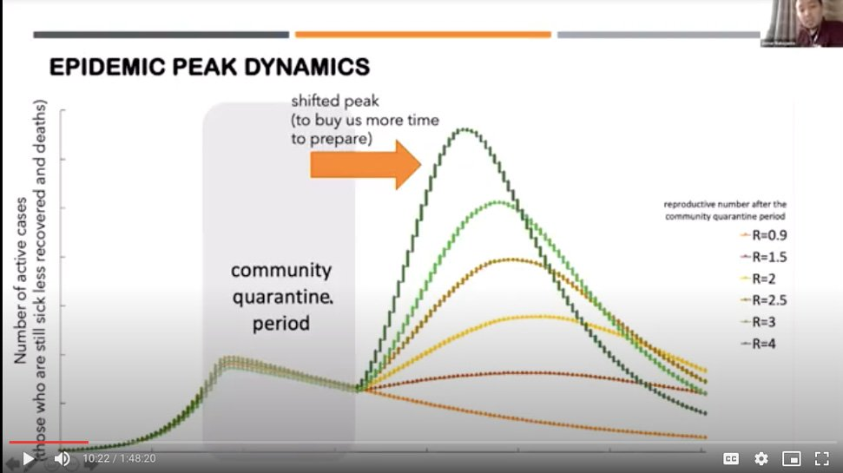
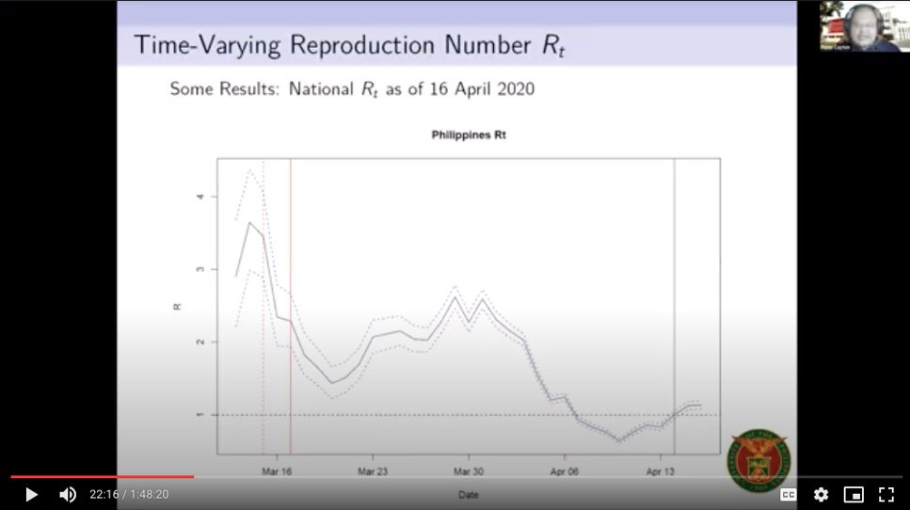
COVID-19 Threshold Model
The response team has drafted a number of policy notes based on the results of their studies, including recommendations for a graduated activation of the ECQ that depends on the level of risk per area.

Slide 21

Working with the national government
Team members have also given presentations to the President and the Inter-Agency Task Force on Emerging Infectious Disease (IATF). Given their highly specialized competencies, members have been called to join the IATF Technical Working Group on Anticipatory and Forward Planning.

Slide 22
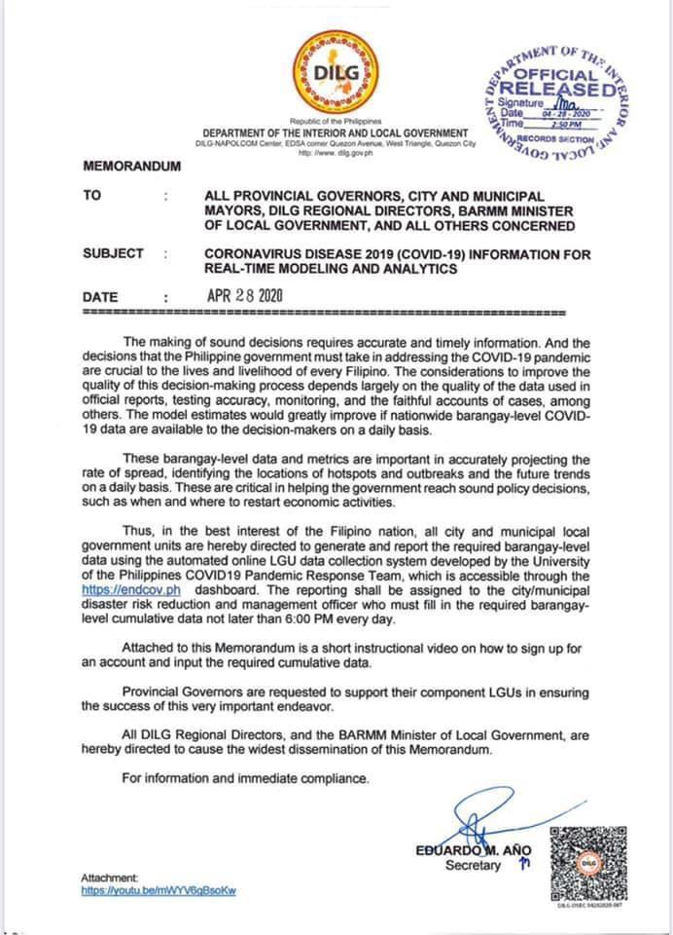
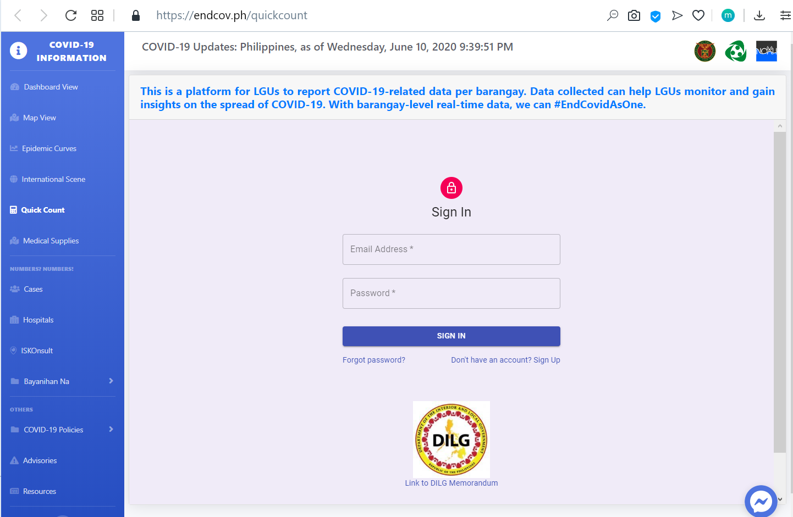
Coordination with the LGUs

Slide 23



Aside from working with national and local government units, the UP response team has been collaborating with academics from the National University of Singapore, University of California Davis and University College London as well as local academic institutions.
On the international front, the team has joined the Forecast-based Warning, Analysis and Response Network (FOREWARN), an organization of academics, scientists and humanitarian workers.

Slide 24
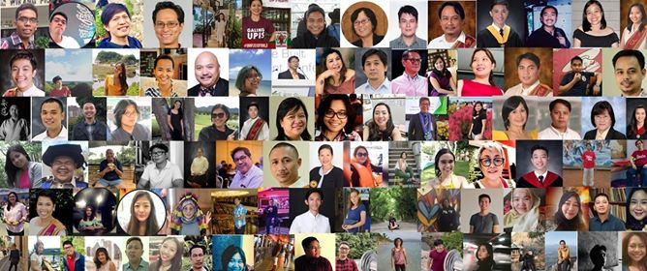

Slide 25
About UP COVID-19 Pandemic Response Team
Projects I am Involved In:
1. Epidemic Curves of the UP COVID-19 Pandemic Response Team
2. ENDCOV Map on current active cases and probability of outbreak
3. LGU Data Analytics Group
4. Compendium of COVID-19 Statistics for Island Groups, Regions, Provinces, Cities, and Municipalities
5. PSPHP Graphs, Time Varying-R Dashboard with the LEADS 4 Health Security and Resilience

Slide 26
About UP COVID-19 Pandemic Response Team
Platform:
https://endcov.up.edu.ph
Contact Us:
upri.covid19@up.edu.ph

Slide 27
About the L4H Consortium

Slide 28
About the L4H Consortium
Leading Evidence-based Actions through Data Science for Health Security and Resilience
A consortium of data scientists, physicians, mathematicians, and epidemiologists, convened by the Philippine Society of Public Health Physicians (PSPHP)
website: https://leads4health.org/l4h/

Slide 29
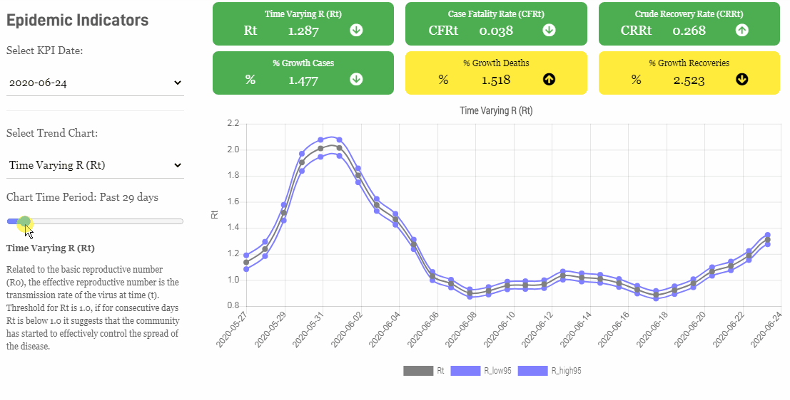
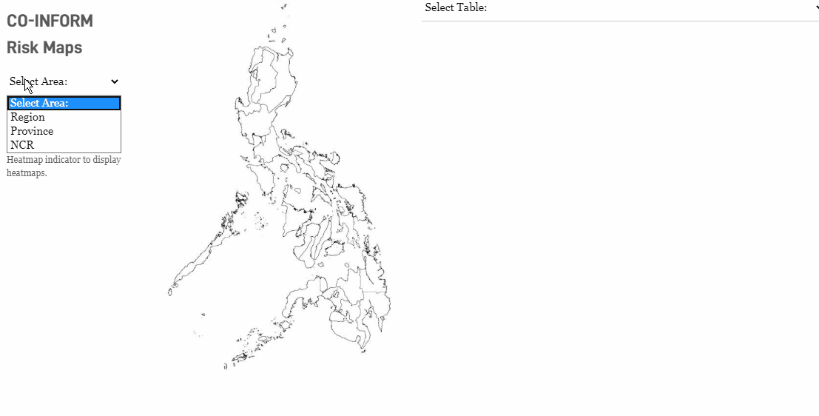
About the L4H Consortium

Slide 30
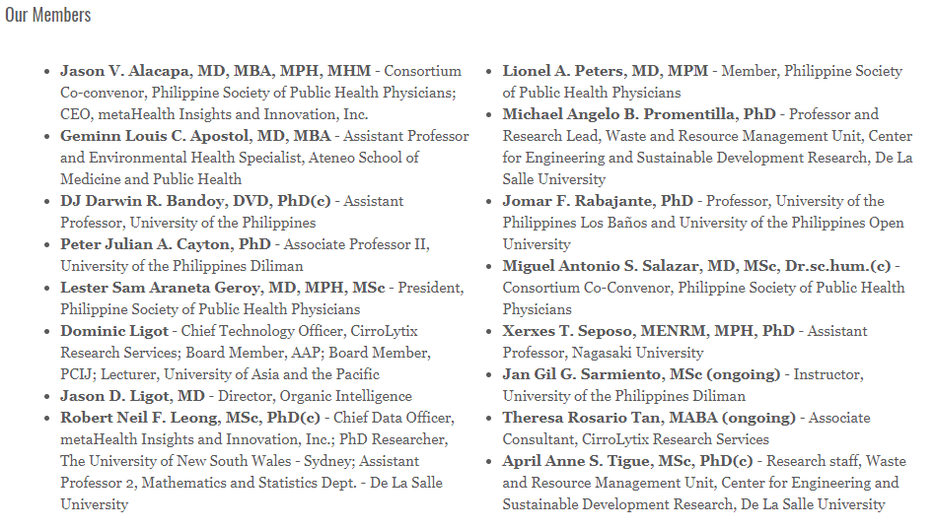
About the L4H Consortium

Slide 31

About the L4H Consortium

Slide 32
Example Projects

Slide 33
Example Projects
Epidemiological Statistics for COVID-19 (w/UP PRT)
> Compiling epidemiological statistics for website and PDF statistical reports outputs
Short-term Forecasting of COVID-19 Cases (w/ L4H)
> Forecasting for national and regional reported case counts of COVID-19
Mapping COVID-19 Cases (w/ UP PRT)
> Mapping the distribution of active cases and case per 100,000 population by barangay in the Philippines

Slide 34
Demonstrating the Workflow with a Team using Example Projects

Slide 35
Demonstrating the Workflow with a Team using Example Projects
Project | Import
Epidemiological Statistics for COVID-19 (w/UP PRT) | Primary Data Source: DOH Data Drop for the Case Information Dataset [https://bit.ly/DataDropPH] Secondary Data Source: PSGC Data with 2020 Population Counts [https://psa.gov.ph/classification/psgc/downloads/2_PSGC%202Q-2022-Publication-Datafile.xlsx] Researchers: Trixie Delmendo, UPRI; Peter Julian Cayton, UP PRT
Short-term Forecasting of COVID-19 Cases (w/ L4H)
Mapping COVID-19 Cases (w/ UP PRT)

Slide 36
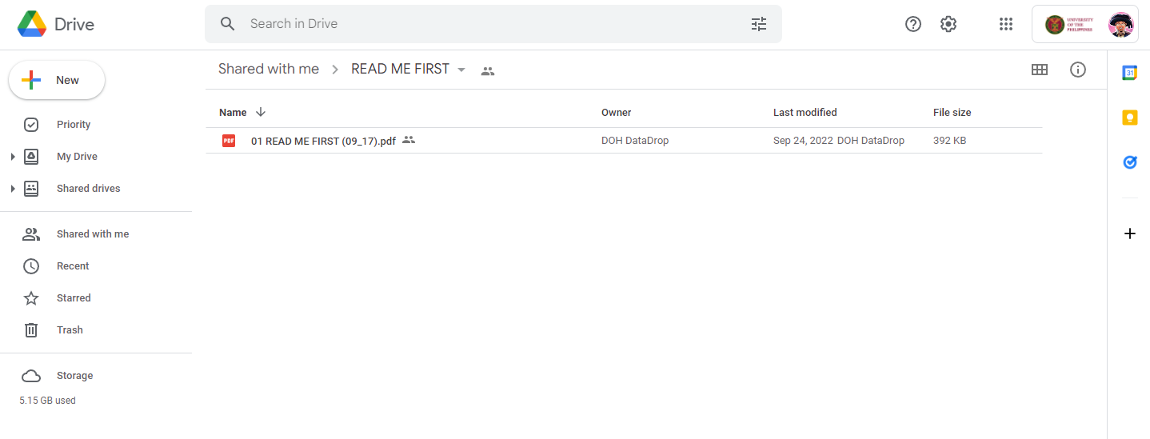
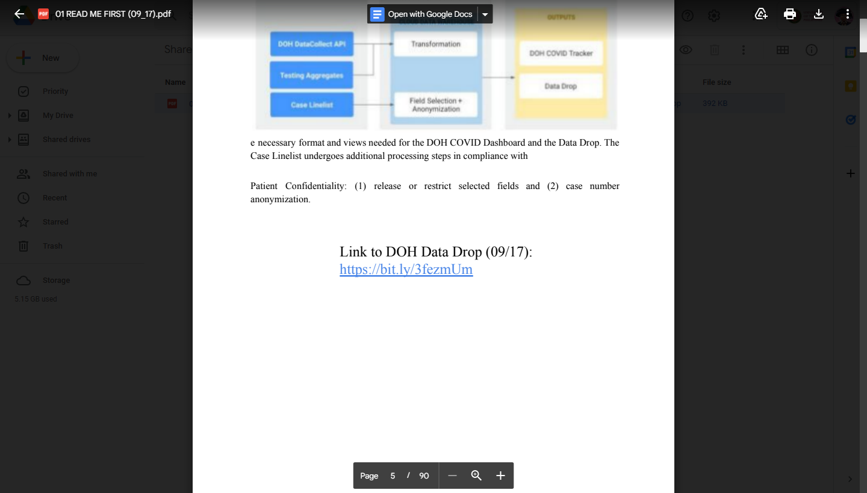
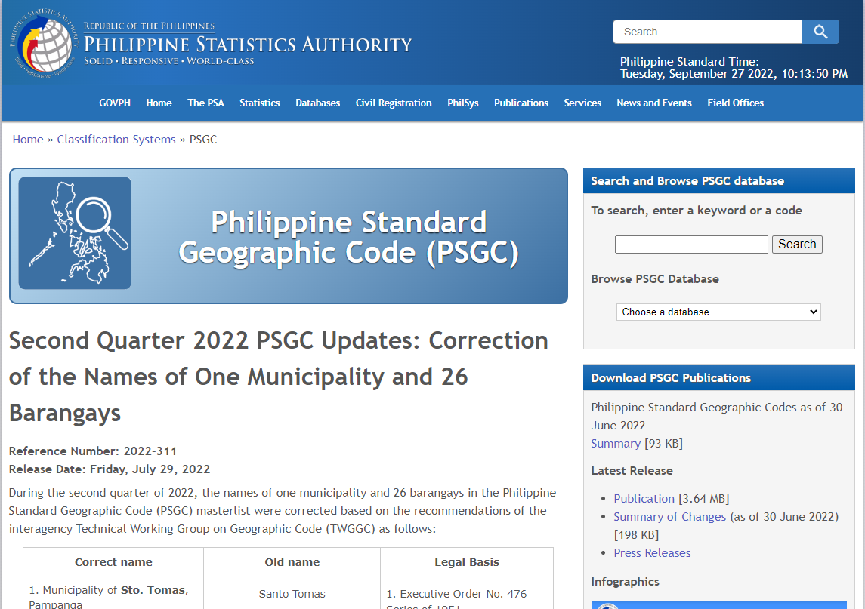
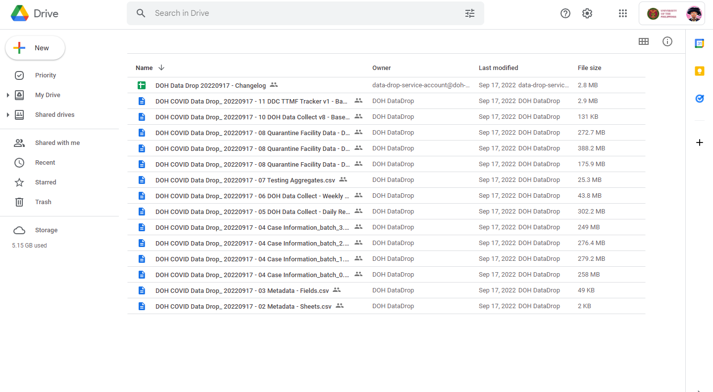
Demonstrating the Workflow with a Team using Example Projects

Slide 37
Demonstrating the Workflow with a Team using Example Projects
Project | Tidy
Epidemiological Statistics for COVID-19 (w/UP PRT) | Procedures: Reconcile and correct residence variable matched with PSGC data, assuming Barangay PSGC as supreme location variable Reconcile between dataset versions to add missing recovery dates Researchers: Trixie Delmendo, UPRI; Jan Gil Sarmiento, UPD SS Peter Julian Cayton, UP PRT
Short-term Forecasting of COVID-19 Cases (w/ L4H)
Mapping COVID-19 Cases (w/ UP PRT)

Slide 38
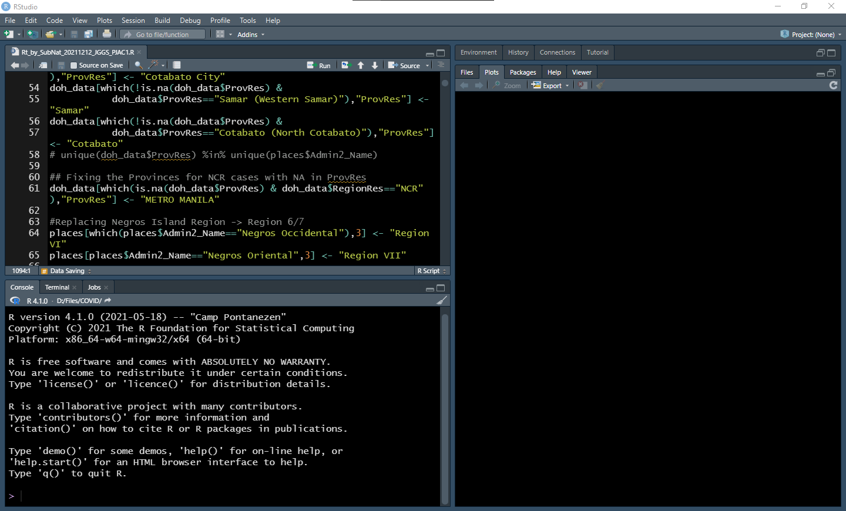
Demonstrating the Workflow with a Team using Example Projects

Slide 39
Demonstrating the Workflow with a Team using Example Projects
Project | Transform
Epidemiological Statistics for COVID-19 (w/UP PRT) | Procedures: Group data by geographic hierarchy: 1) National, 2) Island Group, 3) Regional, 4) Provincial, 5) City/Municipality Compute for cumulative and new counts for cases, recoveries, deaths, and active cases per date per hierarchy Compute for case rates such as recovery rates, fatality rates, and doubling times Researchers: Jan Gil Sarmiento, UPD SS; Peter Julian Cayton, UP PRT
Short-term Forecasting of COVID-19 Cases (w/ L4H) | Procedures: Group data by geographic hierarchy: 1) National and 2) Regional Compute for new counts for cases per date per hierarchy Researchers: Jan Gil Sarmiento, Simon Bismonte, Maryliz Zubiri, and Nicole Uy
Mapping COVID-19 Cases (w/ UP PRT) | Procedures: Group data by geographic location: Barangay via PSGC Compute for total counts for cases, recoveries, deaths, and active cases per barangay Compute for case per 100,000 population using PSGC population data and case counts by barangay. Researchers: Trixie Delmendo, UP RI; Peter Julian Cayton, UP PRT

Slide 40
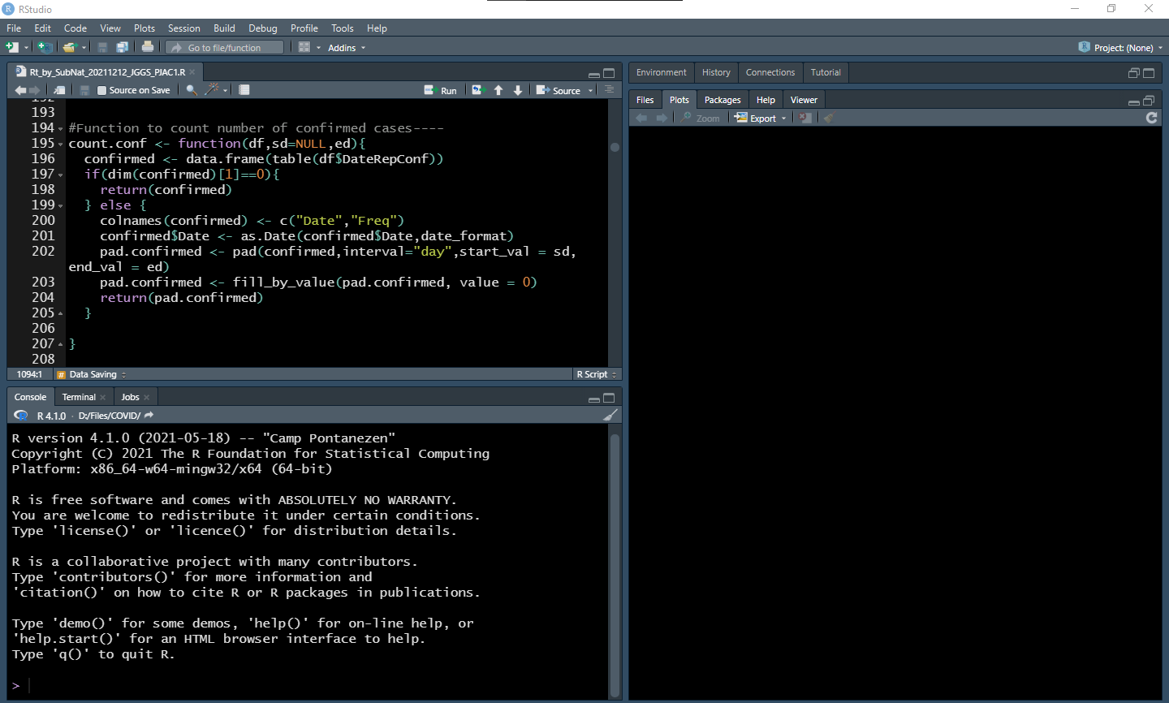
Demonstrating the Workflow with a Team using Example Projects

Slide 41
Demonstrating the Workflow with a Team using Example Projects
Project | Visualize
Epidemiological Statistics for COVID-19 (w/UP PRT) | Procedures: Generate plots of cases, recoveries, deaths, and active cases per hierarchy Researchers: Jan Gil Sarmiento, UPD SS; Peter Julian Cayton, UP PRT
Short-term Forecasting of COVID-19 Cases (w/ L4H) | Procedures: Generate plots of cases per hierarchy Researchers: Jan Gil Sarmiento, Simon Bismonte, Maryliz Zubiri, and Nicole Uy
Mapping COVID-19 Cases (w/ UP PRT) | Procedures: Produce a map of active case distribution in which case dots are randomly distributed within their barangay of residence Produce a color map of case per 100,000 by barangay of residence with the barangay colors done by belonging into an interval Researchers: Trixie Delmendo, UP RI; Steffanie Chua, UP RI; Jake Mendoza, UP RI; Feye Andal, UP RI; UP Resilience Youth Mappers; Peter Julian Cayton, UP PRT

Slide 42
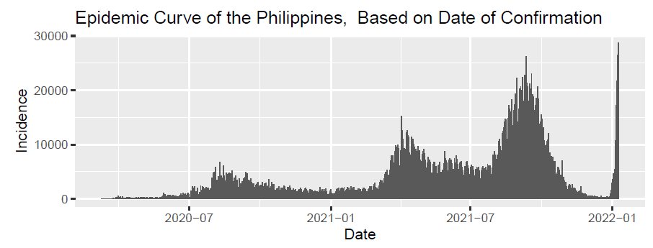
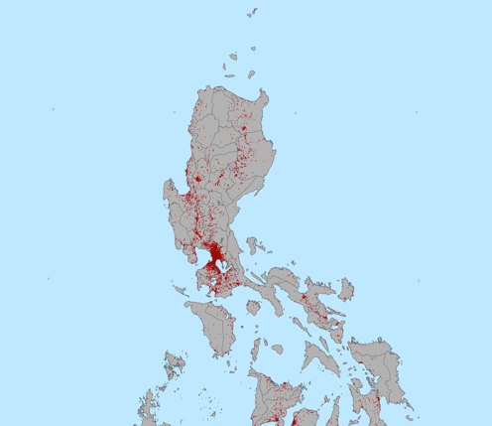
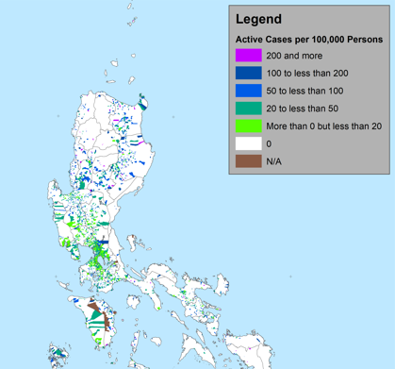
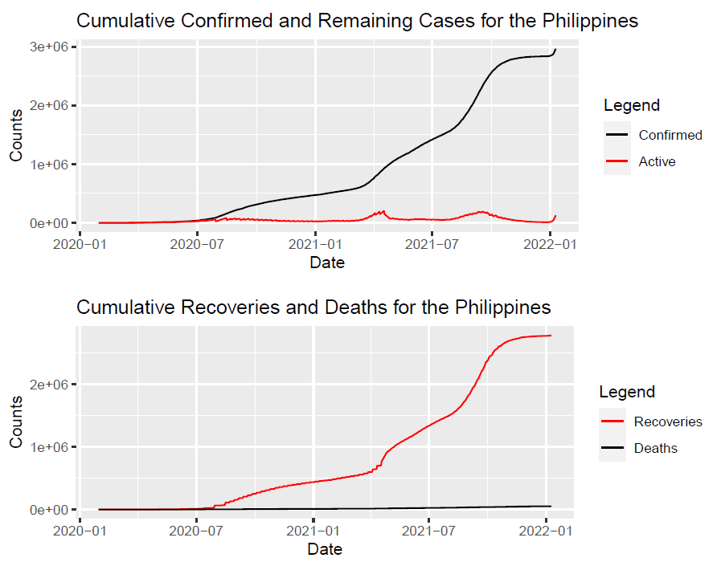
Demonstrating the Workflow with a Team using Example Projects

Slide 43
Demonstrating the Workflow with a Team using Example Projects
Project | Model
Epidemiological Statistics for COVID-19 (w/UP PRT) | Procedures: Generate the time-varying reproduction number based on an existing Bayesian estimation technique Researchers: Jan Gil Sarmiento, UPD SS; Peter Julian Cayton, UP PRT
Short-term Forecasting of COVID-19 Cases (w/ L4H) | Procedures: Generate the short-term forecasts assuming a model based on the Epiforecasts methodology Researchers: Jan Gil Sarmiento, Simon Bismonte, Maryliz Zubiri, Peter Julian Cayton, Robert Neil Leong
Mapping COVID-19 Cases (w/ UP PRT) | (none)

Slide 44
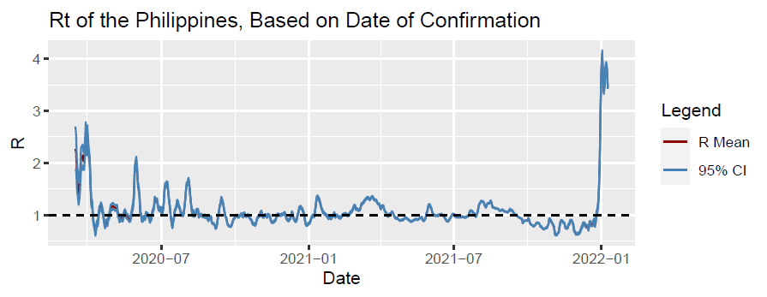
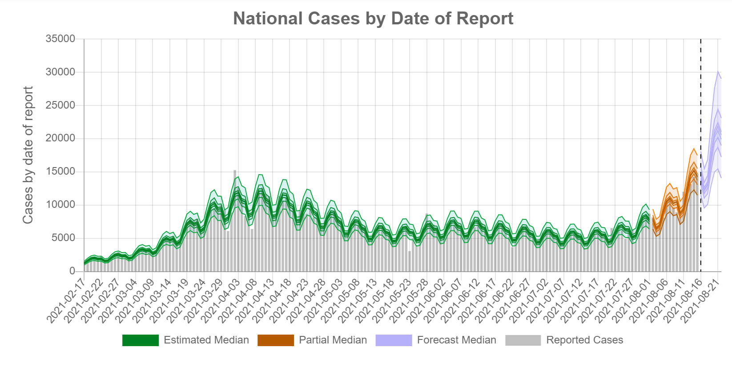
Demonstrating the Workflow with a Team using Example Projects

Slide 45
Demonstrating the Workflow with a Team using Example Projects
Project | Communicate
Epidemiological Statistics for COVID-19 (w/UP PRT) | Procedures: Publish a website page for uploading the statistics Generate a PDF report file Researchers: Feye Andal and developers from the UP RI; Peter Julian Cayton, UP PRT
Short-term Forecasting of COVID-19 Cases (w/ L4H) | Procedure: Publish the results through the L4H website Researchers: Dominic Ligot, Mark Toledo, and Angelica Mhay Salazar
Mapping COVID-19 Cases (w/ UP PRT) | Procedure: Produce maps based on the results Researchers: Trixie Delmendo, UP RI; Steffanie Chua, UP RI; Jake Mendoza, UP RI; mappers and research of the UP RI and UP RI Youthmappers,

Slide 46
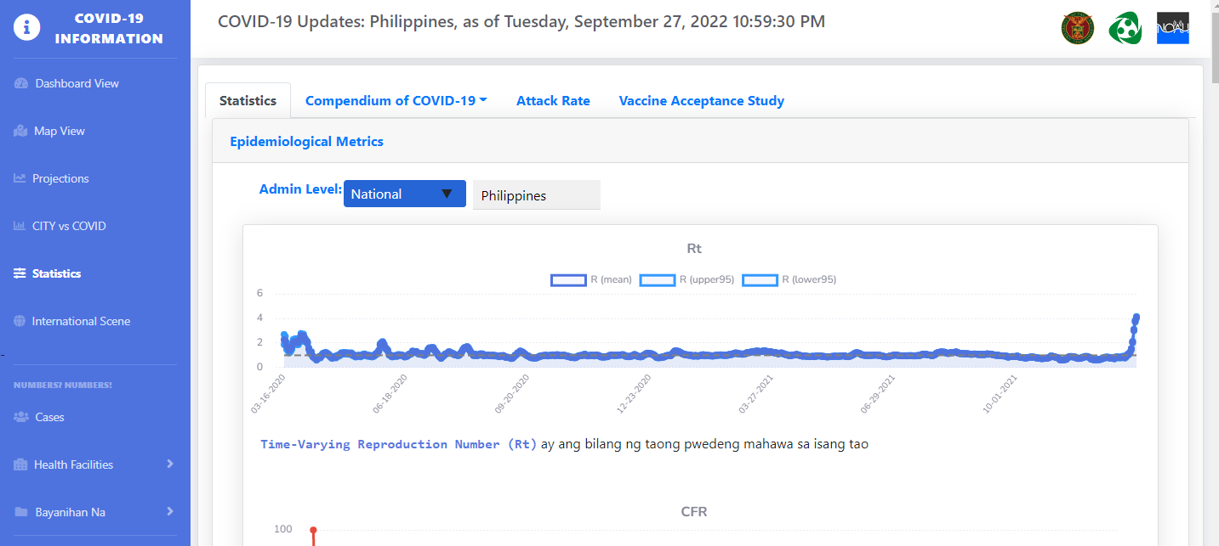
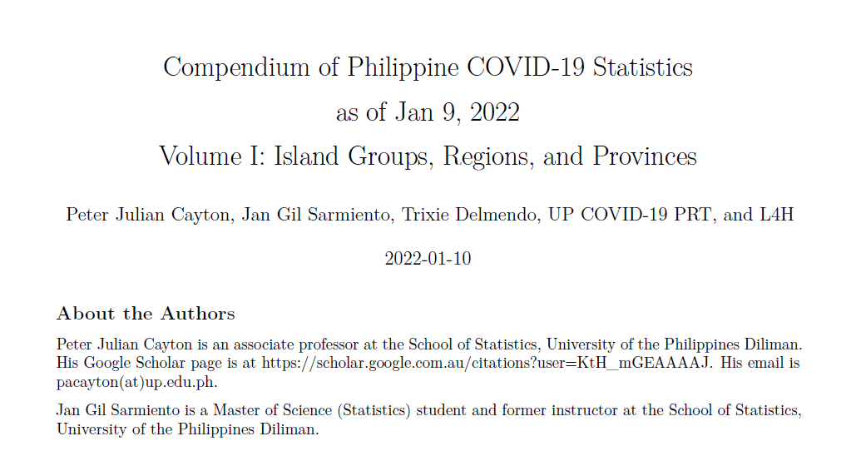
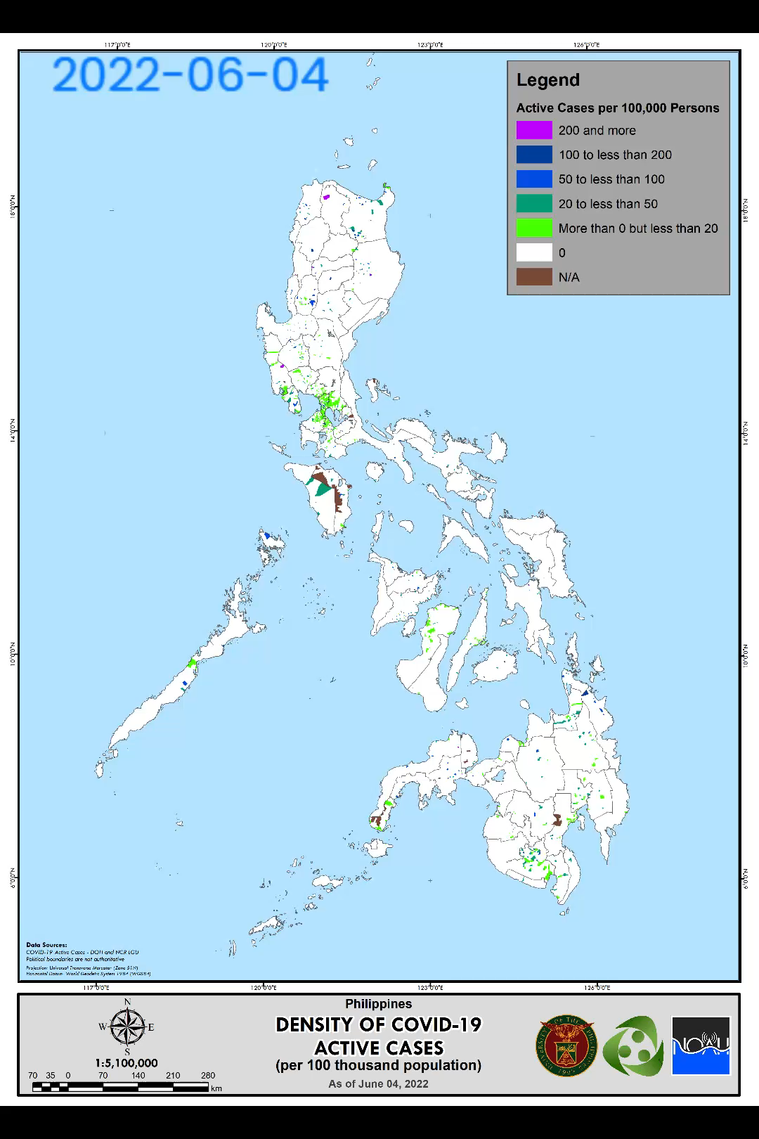
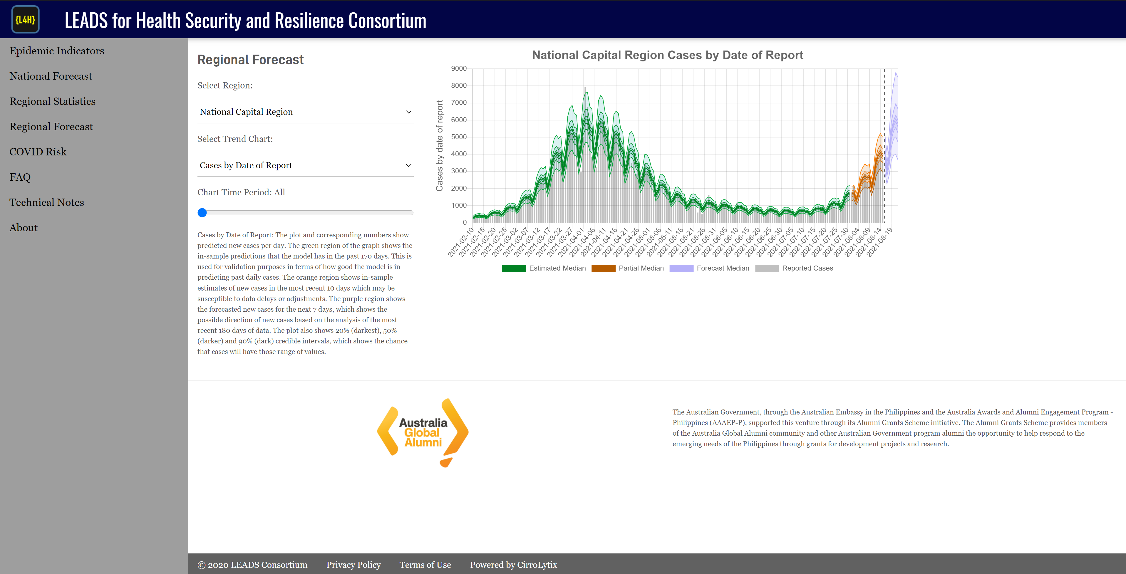
Demonstrating the Workflow with a Team using Example Projects

Slide 47
Closing Remarks

Slide 48
Closing Remarks
Data science involves not only technical skills such as programming, statistics, and subject matter knowledge, but also communication and team collaboration
By making data science projects in teams, the burden per person is reduced and high-quality data products are produced.
Utilize each member’s comparative advantage skills to maximize quality of output
Build cohesion and empathy as a team of analysts and scientists producing data products

Slide 49
Thanks and stay safe always!

